Slide 1

Coin Change DP
Arun Joshua Kennedy

Slide 2
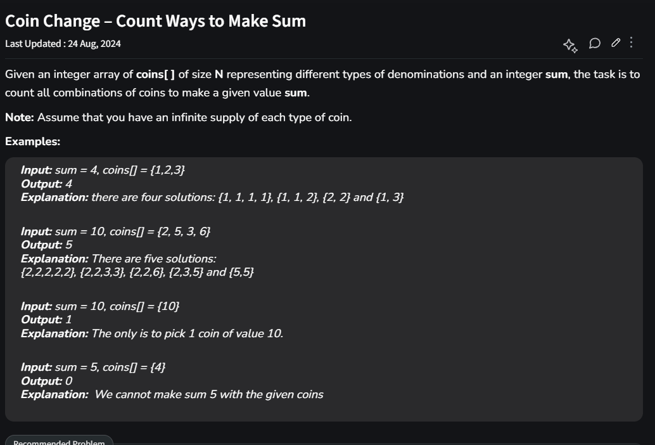


Geeks For Geeks
Count all combinations of coins to make a given value sum (target).

Slide 3
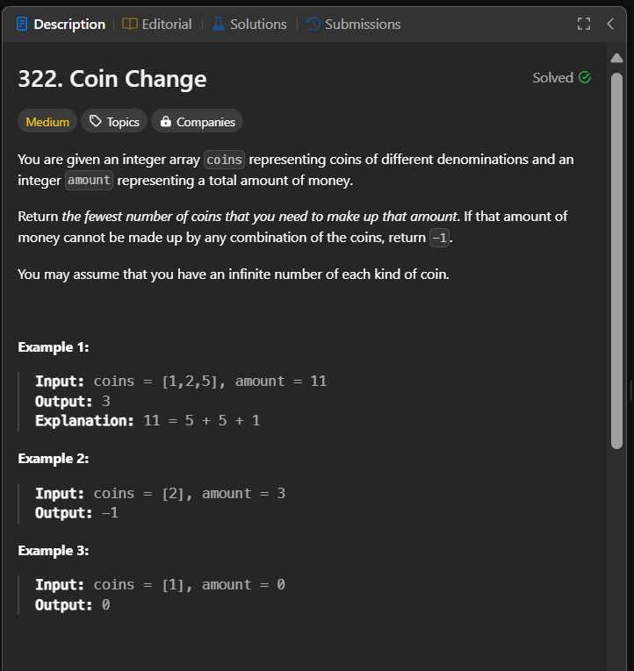

Leet Code
Fewest number of coins that you need to make up that amount (target).

Slide 4
Objective
Given a target and the coins. Check if it is possible to achieve the target amount with the coins provided (Boolean True/False output)
We discuss 2 variants:
For each denomination infinite coins. Eg for [ 1, 2, 3] we can take infinite 1s, 2s and 3s, Repetitions will have no effect.
Finite coins for each denomination. Eg for [1, 2, 3] we can take each only once so here the maximum target is naturally 6. Repetitions will affect the outcome. Eg, [1, 2, 2, 3] can reach 8. (Coin Change(Finite Supply) - Naukri Code 360)

Slide 5
Infinite Coins Python code
def count(coins, n, target):
# Assuming coins does not contain any duplications
dp = [False] * (target + 1)
dp[0] = True # Base case
# Iterate through each coin
for i in range(n):
# Update possible sums from the coin value up to target
for j in range(coins[i], target + 1):
dp[j] |= dp[j - coins[i]]
return dp[target]

Slide 6
Infinite Coins
coins=[3, 5], n=2, target=6, dp=[True, False, False, False, False, False, False]
coins[i=0]=3, j=3, dp=[True, False, False, True, False, False, False]
coins[i=0]=3, j=4, dp=[True, False, False, True, False, False, False]
coins[i=0]=3, j=5, dp=[True, False, False, True, False, False, False]
coins[i=0]=3, j=6, dp=[True, False, False, True, False, False, True]
coins[i=1]=5, j=5, dp=[True, False, False, True, False, True, True]
coins[i=1]=5, j=6, dp=[True, False, False, True, False, True, True]
Is it possible to achieve the target 6: True
for i in range(n):
for j in range(coins[i], target + 1):
dp[j] |= dp[j - coins[i]]

Slide 7
Finite Coins Python Code
def count(coins, n, target):
dp = [False] * (target + 1)
dp[0] = True
for i in range(n):
for j in range(target, coins[i] - 1, -1):
dp[j] |= dp[j - coins[i]]
return dp[target]

Slide 8
Finite Coins
for i in range(n):
for j in range(target, coins[i] - 1, -1):
dp[j] |= dp[j - coins[i]]
coins=[3, 5], n=2, target=6, dp=[True, False, False, False, False, False, False]
coins[i=0]=3, j=6, dp=[True, False, False, False, False, False, False]
coins[i=0]=3, j=5, dp=[True, False, False, False, False, False, False]
coins[i=0]=3, j=4, dp=[True, False, False, False, False, False, False]
coins[i=0]=3, j=3, dp=[True, False, False, True, False, False, False]
coins[i=1]=5, j=6, dp=[True, False, False, True, False, False, False]
coins[i=1]=5, j=5, dp=[True, False, False, True, False, True, False]
Is it possible to achieve the target 6: False

Slide 9
Finite Coins eg2
coins=[3, 3, 5], n=3, target=6, dp=[True, False, False, False, False, False, False]
coins[i=0]=3, j=6, dp=[True, False, False, False, False, False, False]
coins[i=0]=3, j=5, dp=[True, False, False, False, False, False, False]
coins[i=0]=3, j=4, dp=[True, False, False, False, False, False, False]
coins[i=0]=3, j=3, dp=[True, False, False, True, False, False, False]
coins[i=1]=3, j=6, dp=[True, False, False, True, False, False, True]
coins[i=1]=3, j=5, dp=[True, False, False, True, False, False, True]
coins[i=1]=3, j=4, dp=[True, False, False, True, False, False, True]
coins[i=1]=3, j=3, dp=[True, False, False, True, False, False, True]
coins[i=2]=5, j=6, dp=[True, False, False, True, False, False, True]
coins[i=2]=5, j=5, dp=[True, False, False, True, False, True, True]
Is it possible to achieve the target 6: True

Slide 10
The net effect of the 2 Algorithms
To understand this let us take the coins = [3, 5] and target = 18
Infinite coins for each denomination we get:
dp=[True, False, False, True, False, True, True, False, True, True, True, True, True, True, True, True, True, True, True]
Finite coins we get:
dp=[True, False, False, True, False, True, False, False, True, False, False, False, False, False, False, False, False, False, False]

Slide 11

Summary
For Infinite coins of each denomination
for i in range(n):
# Update possible sums from the coin value up to target
for j in range(coins[i], target + 1):
dp[j] |= dp[j - coins[i]]
For Finite coins
for i in range(n):
for j in range(target, coins[i] - 1, -1):
dp[j] |= dp[j - coins[i]]

Slide 12
Summary
This algorithm does not directly translate to Counting the number of ways the coins can be chosen. For both Infinite supply for each denomination and finite supply.

Slide 13
Counting the Combination of coins
def count(coins, target):
coins = list(set(coins))
n = len(coins)
dp = [0 for k in range(target+1)]
dp[0] = 1
for i in range(0, n):
for j in range(coins[i], target+1):
dp[j] += dp[j-coins[i]]
return dp[target]
coins=[1, 2, 3], n=3, target=3, dp=[1, 0, 0, 0]
coins[i=0]=1, j=1, dp=[1, 1, 0, 0]
coins[i=0]=1, j=2, dp=[1, 1, 1, 0]
coins[i=0]=1, j=3, dp=[1, 1, 1, 1]
coins[i=1]=2, j=2, dp=[1, 1, 2, 1]
coins[i=1]=2, j=3, dp=[1, 1, 2, 2]
coins[i=2]=3, j=3, dp=[1, 1, 2, 3]
Number of ways to make change for 3 is 3

Slide 14
Thank You

Slide 15
References
Coin Change – LeetCode
Coin Change - Count Ways to Make Sum – GeeksforGeeks
Coin change problem with limited coins – GeeksforGeeks
Coin Change(Finite Supply) - Naukri Code 360

Slide 16
Infinite Coins
coins=[3, 5], n=2, target=6, dp=[True, False, False, False, False, False, False]
coins[i=0]=3, j=3, dp=[True, False, False, -> True, False, False, False]
coins[i=0]=3, j=4, dp=[True, False, False, True, -> False, False, False]
coins[i=0]=3, j=5, dp=[True, False, False, True, False, -> False, False]
coins[i=0]=3, j=6, dp=[True, False, False, True, False, False, -> True]
coins[i=1]=5, j=5, dp=[True, False, False, True, False, -> True, True]
coins[i=1]=5, j=6, dp=[True, False, False, True, False, True, -> True]
Is it possible to achieve the target 6: True
for i in range(n):
for j in range(coins[i], target + 1):
dp[j] |= dp[j - coins[i]]

